Slide 1
Open Research Data & H2020
Sarah Jones
Digital Curation Centre, Glasgow
sarah.jones@glasgow.ac.uk
Twitter: @sjDCC
OpenAIRE webinar, The National Documentation Centre (EKT), Athens, 22 March 2017

Slide 2
Overview
The Horizon 2020 Open Research Data pilot
What is the scope?
What is required?
How and when to opt out?
Data Management Planning
What is a DMP?
How to plan?
Tools and examples
Making data open
How to make data open
Resources for metadata standards, licences, repositories…
Local support & services

Slide 3
H2020 Open Research Data Pilot
Image CC-BY-NC-SA by Tom Magllery www.flickr.com/photos/lwr/13442910354

Slide 4
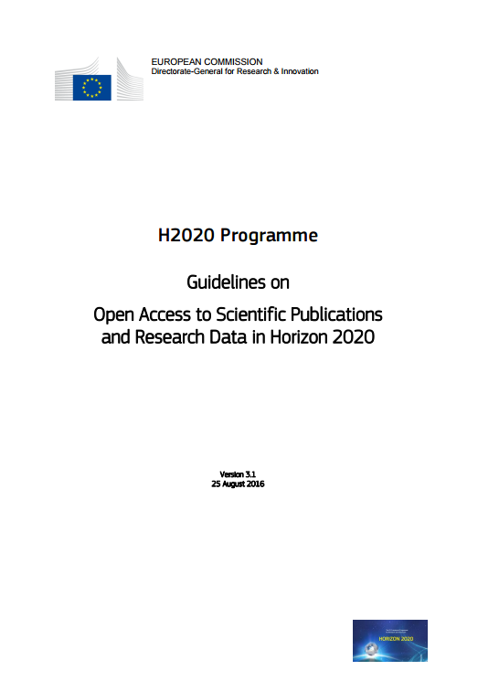
Why open access and open data?
“The Commission considers that there should be no need to pay for information funded from the public purse each time it is accessed or used. Moreover, it should benefit European businesses and the public to the full.”
https://ec.europa.eu/research/participants/data/ref/h2020/grants_manual/hi/oa_pilot/h2020-hi-oa-pilot-guide_en.pdf
Notes:
The background to this is about making the most of the data that has been created through publicly funded research. The guidelines speak of:
Improved quality of results
Greater efficiency
Faster to market = faster growth
Improved transparency of the scientific process

Slide 5
Development of EC Open Access policy
Pilot in FP7
Provision of support
OA mandate in H2020
Trialled in 7 areas
Expected to:
Deposit articles into a repository
Attempt to make these OA within 6 or 12 months
OA fees are eligible for reimbursement
Pilot supported and monitored through OpenAIRE
Each beneficiary must:
Deposit machine-readable electronic copy in repository by the date of publication
Ensure OA via green/gold routes within 6 or 12 month embargo
Ensure bibliographic metadata is OA
Aim to deposit research data
Notes:
Moving from a ‘best-effort’ in FP7 to an ‘obligation’ under Horizon 2020

Slide 6
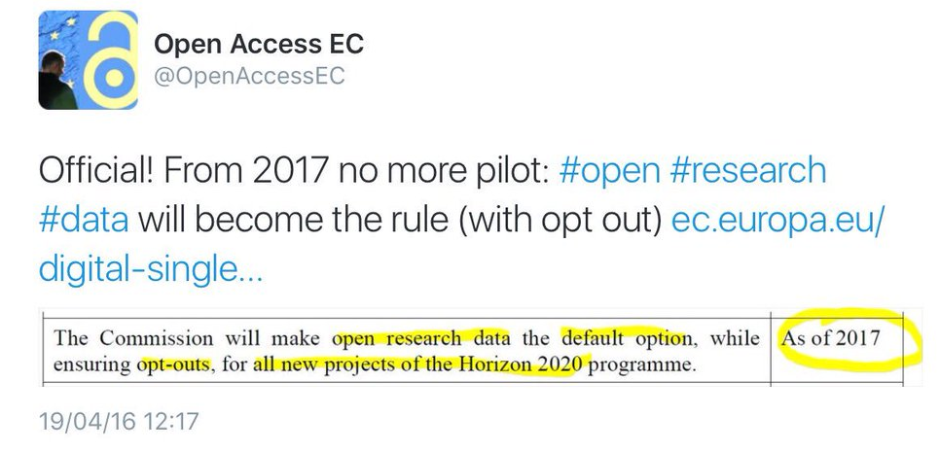
H2020 open data pilot
Guidelines on FAIR Data Management in Horizon 2020
http://ec.europa.eu/research/participants/data/ref/h2020/grants_manual/hi/oa_pilot/h2020-hi-oa-data-mgt_en.pdf
Pilot in H2020
Provision of support
?
Expanded to open data by default

Slide 7
Open Research Data (ORD) Pilot
Pilot focuses on research data specifically
'Research data' refers to information, in particular facts or numbers, collected to be examined and considered and as a basis for reasoning, discussion, or calculation.
In a research context, examples of data include statistics, results of experiments, measurements, observations resulting from fieldwork, survey results, interview recordings and images. The focus is on research data that is available in digital form.
Guidelines on Open Access to Scientific Publications and Research Data in Horizon 2020, v.3.1, 25 August 2016, p4

Slide 8
Which data does the pilot apply to?
Data, including associated metadata, needed to validate the results in scientific publications
Other curated and/or raw data, including associated metadata, as specified in the DMP
Doesn’t apply to all data (researchers to define as appropriate)
Don’t have to share data if inappropriate – exemptions apply
Notes:
For those that do take part in the pilot, the starting point is to make all data that underpin publications open. After that, it’s for researchers to define what else should be shared and can be made open. This should be outlined in the DMP.
Sometimes sharing is not appropriate (e.g. due to ethical rules of personal data, intellectual property protection, commercial restrictions etc). It’s fine to apply restrictions in such cases. This could be an embargo period prior to publication or while a patent is sought, or controlling access and re-use to protect participants’ identities (e.g. via the use of secure data services / data enclaves or data sharing agreements). Restrictions should be outlined up-front in the DMP.
8

Slide 9
Key requirements of the open data pilot
Beneficiaries participating in the Pilot will:
Deposit data in a research data repository of their choice
Take measures to make it possible for others to access, mine, exploit, reproduce and disseminate the data free of charge
Provide information about tools and instruments necessary for validating the results (where possible, provide the tools and instruments themselves)
Notes:
So the specific requirements on projects that participate in the pilot are to:
- Deposit data in a repository
Enable reuse via open licensing
Provide any tools (or at least info on them) needed to validate the data
The focus is planning for data sharing and then facilitating that through deposit, licensing and enabling reproducibility
9

Slide 10
Exemptions – reasons for opting out
If results are expected to be commercially or industrially exploited
If participation is incompatible with the need for confidentiality in connection with security issues
Incompatible with existing rules on the protection of personal data
Would jeopardise the achievement of the main aim of the action
If the project will not generate / collect any research data
If there are other legitimate reasons to not take part in the Pilot
Can opt out at proposal stage OR during lifetime of project
Should describe issues in the project Data Management Plan
Notes:
Projects in these seven areas aren’t forced to participate. There are various reasons to opt out e.g. if results can’t be shared due to confidentiality, legal restrictions or commercial opportunities.
Opt out is available at any point. It can also apply to certain parts of the data e.g. they could share some aspects but not others.
10

Slide 12
Key differences in H2020
The Commission does NOT require applicants to submit a DMP at the proposal stage. It’s a deliverable (due by month 6).
A DMP is therefore NOT part of the evaluation
Optional section on data management in proposal is worth doing, especially to help justify costs
A DMP is a living or “active” document that should be updated whenever important changes occur (or at review times)
DMPs available online are typically quite long, but don’t necessarily have to be

Slide 13
Info on RDM: what and when
PROPOSAL STAGE
IN PROJECT
Where relevant*, H2020 proposals can include a section on data management which is evaluated under the criterion ‘Impact’
What types of data will the project generate/collect?
What standards will be used?
How will this data be shared/made available? If not, why?
How will this data be curated and preserved?
* For “Research and Innovation actions” and “Innovation Actions”
DMPs are a project deliverable for those participating in the open data pilot.
Not a fixed document – should evolve and gain precision
Deliver first version within initial 6 months of project
More elaborate versions whenever important changes to the project occur. At least at the review.
Notes:
Although DMPs are a project deliverable and not required at the application stage, proposals can include a section on data management if desired. The info suggested here is similar to the preliminary DMP, so essentially gets that started.
13

Slide 14
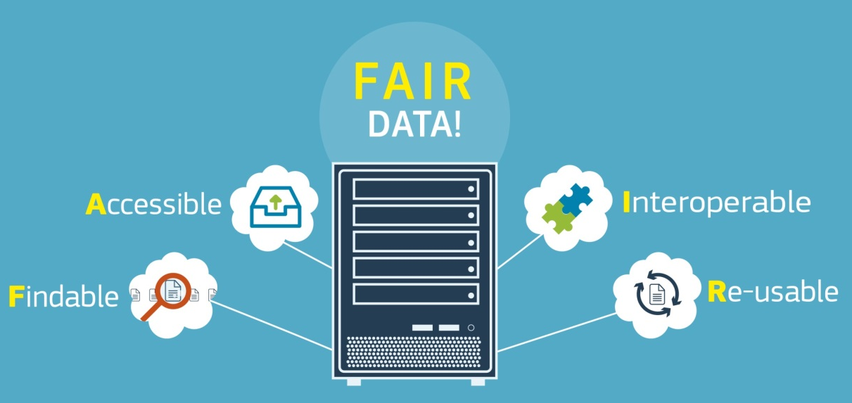
A FAIR approach to DMPs
Findable
Assign persistent IDs, provide metadata, register in a searchable resource...
Accessible
Retrievable by their ID using a standard protocol, metadata remain accessible even if data aren’t...
Interoperable
Use formal, broadly applicable languages, standard vocabularies...
Reusable
Rich metadata, clear licences,
community standards
provenance...
www.force11.org/group/fairgroup/
fairprinciples
Notes:
14

Slide 15
H2020 template
Data summary
FAIR data
2.1 Making data findable, including provisions for metadata
2.2 Making data openly accessible
2.3 Making data interoperable
2.4 Increase data re-use (through clarifying licences)
Allocation of resources
Data security
Ethical aspects
Other issues
http://ec.europa.eu/research/participants/data/ref/h2020/grants_manual/hi/oa_pilot/h2020-hi-oa-data-mgt_en.pdf

Slide 16
Reviewing DMPs in H2020
DMPs are a deliverable, checked primarily by project officers and in some cases external reviewers too
Guidelines are being developed to give reviewers pointers on what to check. These are based on the template.
The reviewer has access to the full project documentation
Process is only just evolving and this is a pilot so feedback may be variable initially

Slide 17
Approach:
as open as possible, as closed as necessary
Image: ‘Balancing rocks’ by Viewminder CC-BY-SA-ND www.flickr.com/photos/light_seeker/7780857224

Slide 18
The EC Open Research Data pilot
Key sources of information
Guidelines on Open Access to Scientific Publications and Research Data in Horizon 2020
http://ec.europa.eu/research/participants/data/ref/h2020/grants_manual/hi/oa_pilot/h2020-hi-oa-pilot-guide_en.pdf
Guidelines on FAIR Data Management in Horizon 2020
http://ec.europa.eu/research/participants/data/ref/h2020/grants_manual/hi/oa_pilot/h2020-hi-oa-data-mgt_en.pdf
Annotated model grant agreement, clause 29.3 http://ec.europa.eu/research/participants/data/ref/h2020/grants_manual/amga/h2020-amga_en.pdf
New infographic summarising key policy points http://ec.europa.eu/research/press/2016/pdf/opendata-infographic_072016.pdf
Notes:
18

Slide 19
Data Management Planning
Image CC-BY-NC-SA by Ralf Appelt www.flickr.com/photos/adesigna/4090782772

Slide 20
What is a DMP?
A DMP is a brief plan to define:
how the data will be created
how it will be documented
who will be able to access it
where it will be stored
who will back it up
whether (and how) it will be shared & preserved
DMPs are often submitted as part of grant applications, but are useful whenever researchers are creating data.
Notes:
A Data Management Plan is often written early on in the research process to determine what data will be created and how it will be managed. Sometime you are asked for a DMP as part of a grant application, but they are useful to write regardless as it helps to develop consistent procedures from the outset.

Slide 21
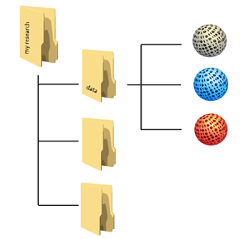
Planning trick 1: think backwards
What data organisation would a re-user like?
CREATING DATA
PROCESSING DATA
ANALYSING DATA
PRESERVING DATA
GIVING ACCESS TO DATA
RE-USING DATA
Notes:
Let’s adopt the perspective of a future data user – maybe yourself: what should your data organisation – folders with data, metadata and documentation – look like at the moment that you start sharing - outside your team - and archiving?
When you are part of a large project which has been going on for some years already, this may be obvious, but for many researchers it isn’t clear from the start.
To answer that broad question, you want to come up, at an early stage, with answers regarding:
Types and formats of data;
New and/or existing;
Expected size;
Metadata;
Documentation;
Software.

Slide 22
Data organisation
http://datasupport.researchdata.nl/en/start-de-cursus/iii-onderzoeksfase/organising-data

Slide 23
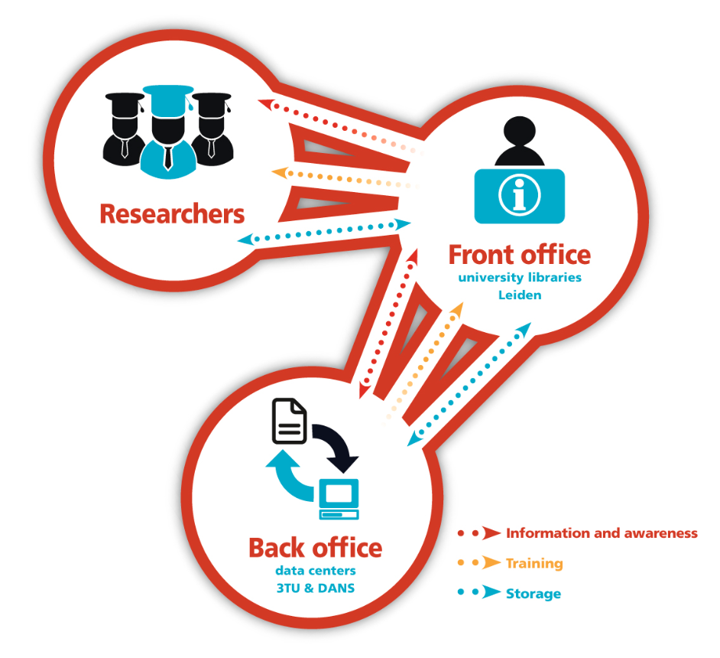
Planning trick 2: include RDM stakeholders
Commercial partners
Institution
RDM policy
Facilities
Publishers
Data Availability policy
€$£
Research funders
www.openaire.eu/briefpaper-rdm-infonoads
Notes:
It’s no fun to do the exercise by yourself, so use this as a communication opportunity.

Slide 24
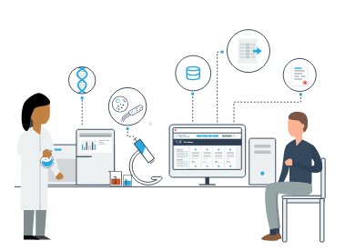
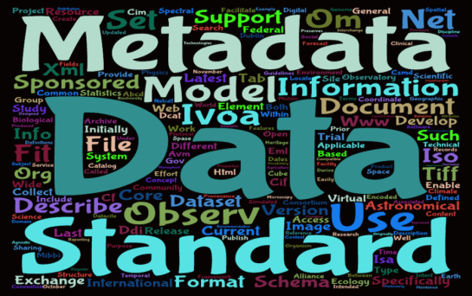
Planning trick 3: ground your plan in reality
Base plans on available skills, support and good practice for the field – show it’s feasible to implement
Different services will be applicable depending on the stage of the research and nature and scale of your data….

Slide 25
Sharing data: what is meant?
With collaborators while research is active
Data are mutable
(Open) data sharing
Data are stable, searchable, citable, clearly licensed
Notes:
These are not the same thing! When the EC asks about your approach to sharing data they’re interested in the latter.

Slide 26
Storing data: what is meant?
Storing and backing up files while research is active
Likely to be on a networked filestore or hard drive
Easy to change or delete
Archiving or preserving data in the long-term
Likely to be deposited in a digital repository
Safeguarded and preserved
Notes:
When data are stored on ‘active data storage’ they’re subject to change. Anyone with permission could edit or delete files. They may still be there in 10 years time, but this is not guaranteed.
An archive is different as the data and associated metadata is packaged up together and protected.
Backup is not the same as preservation. If you want your data to be accessible in the future, you should deposit in a trustworthy digital repository which commits to preserving it.

Slide 27
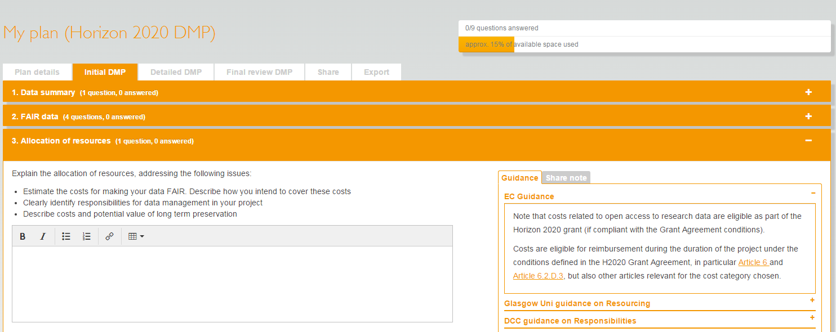
What is DMPonline?
A web-based tool to help researchers write DMPs
Includes a template for Horizon 2020
https://dmponline.dcc.ac.uk

Slide 28
How the tool works
Click to write a generic DMP
Or choose your funder to get their specific template
Pick your uni to add local guidance and to get their template if no funder applies
Choose any additional optional guidance
Notes:
From the start, the DCC has offered guidance, independent of funder or discipline. EUDAT and OpenAIRE and others are developing extra guidance as well.

Slide 29
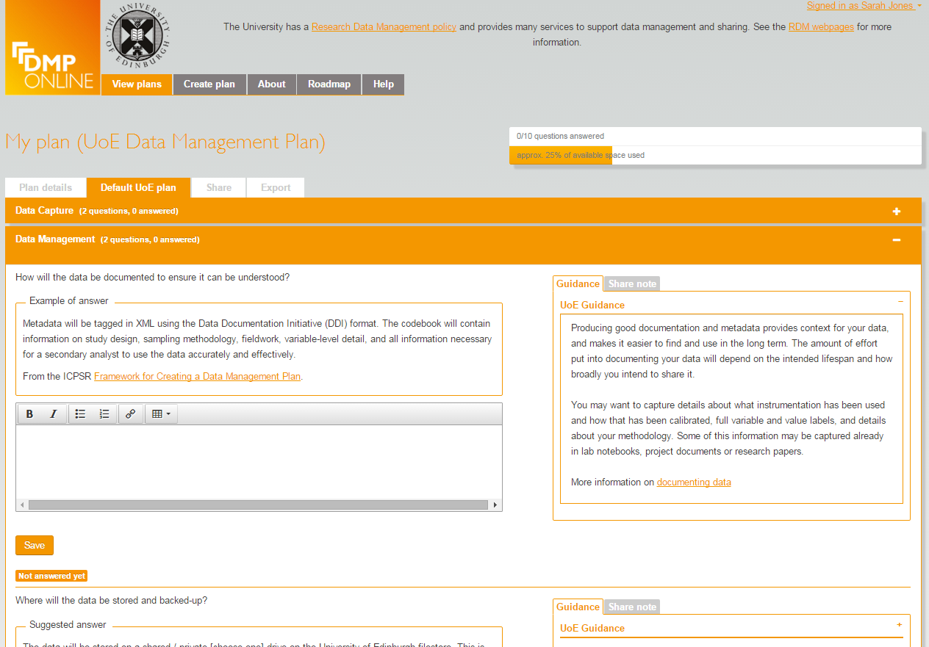
Options for unis to customise DMPonline
Organisations can:
Add their own template(s)
Customise existing funder templates
Provide example and suggested answers
Local guidance with links to support and services
Include their own logo and text in a banner
Review basic statistics
…

Slide 30
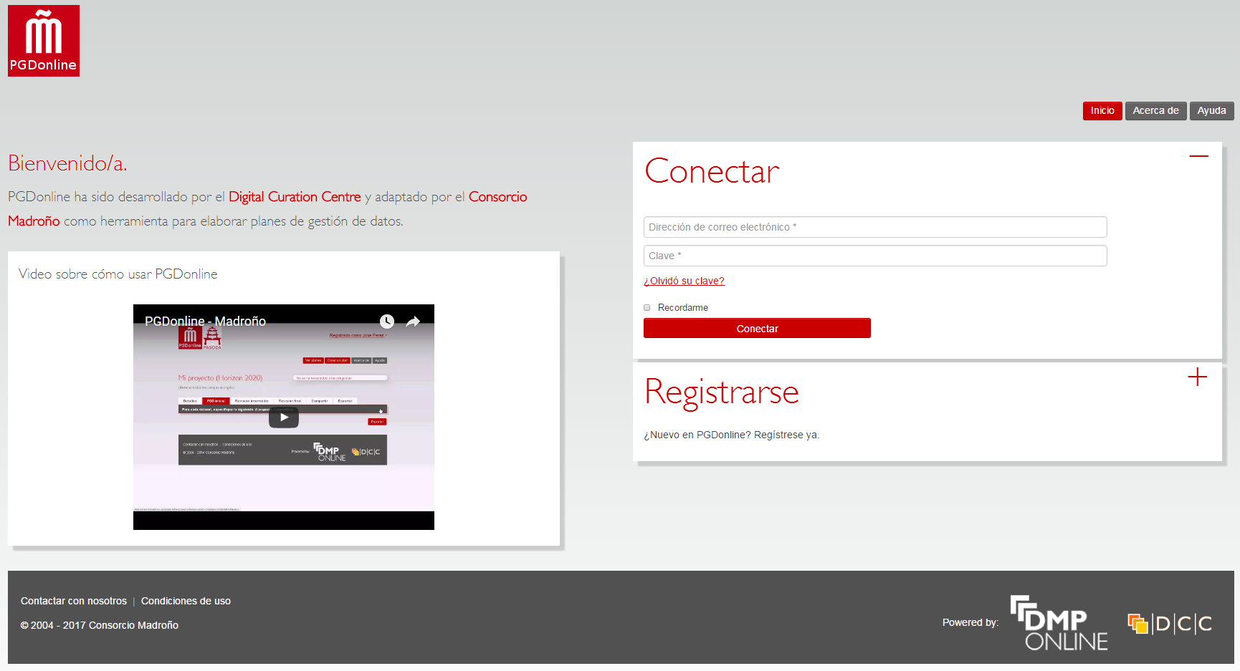
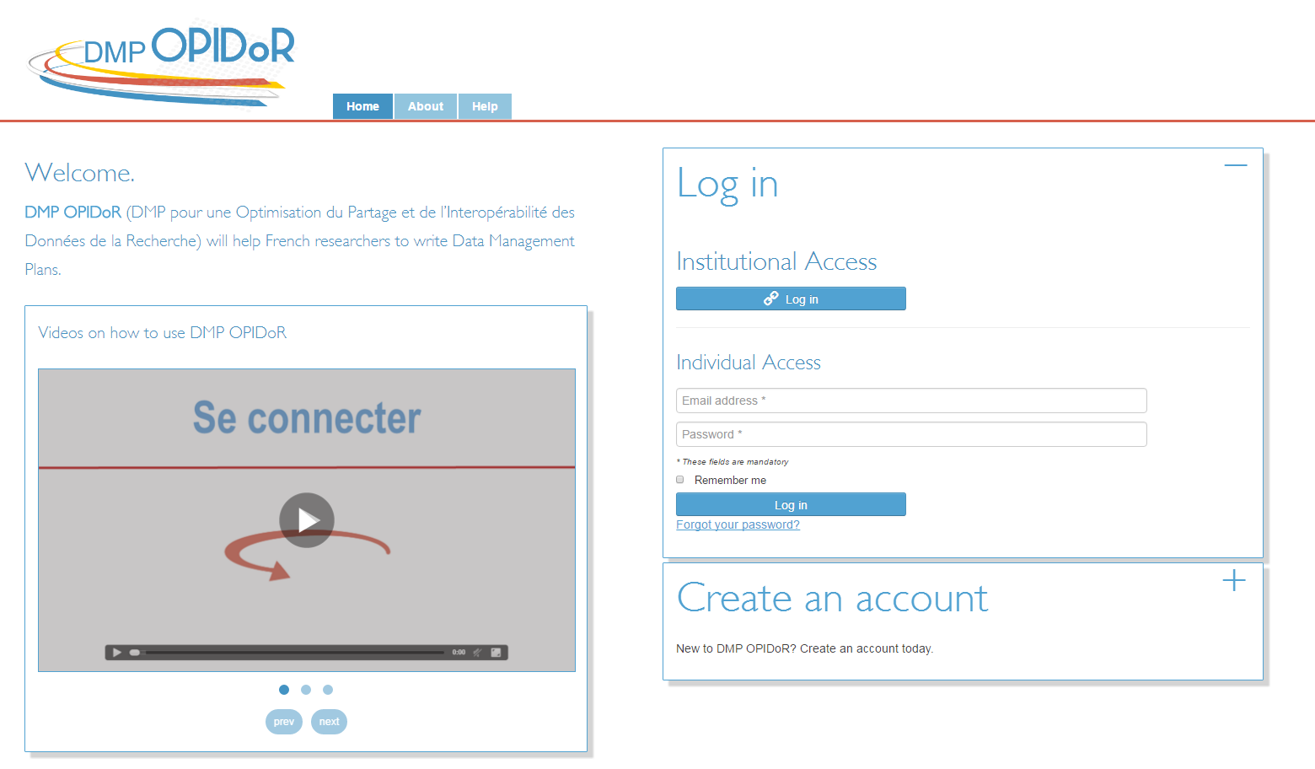
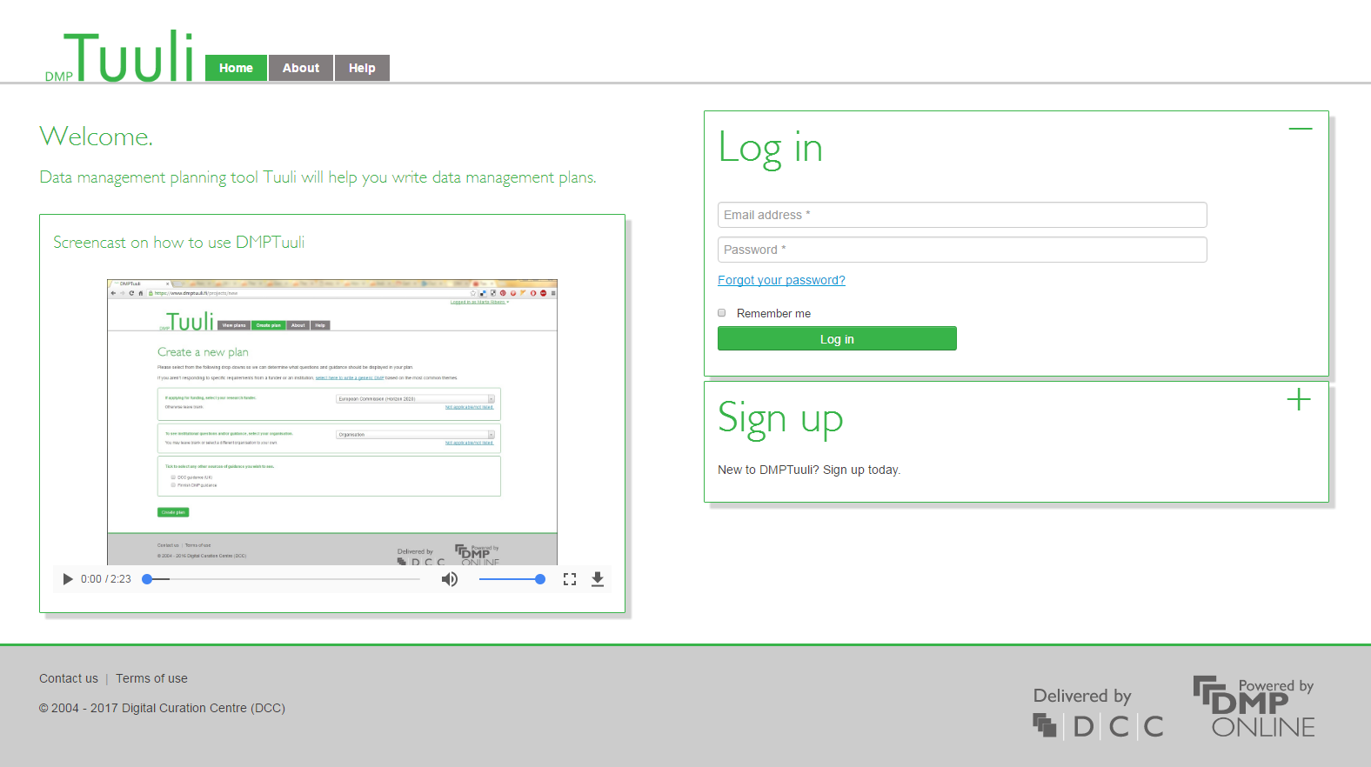
National / local DMP Tools
https://github.com/DMPRoadmap/roadmap/wiki/Local-installations-inventory

Slide 31
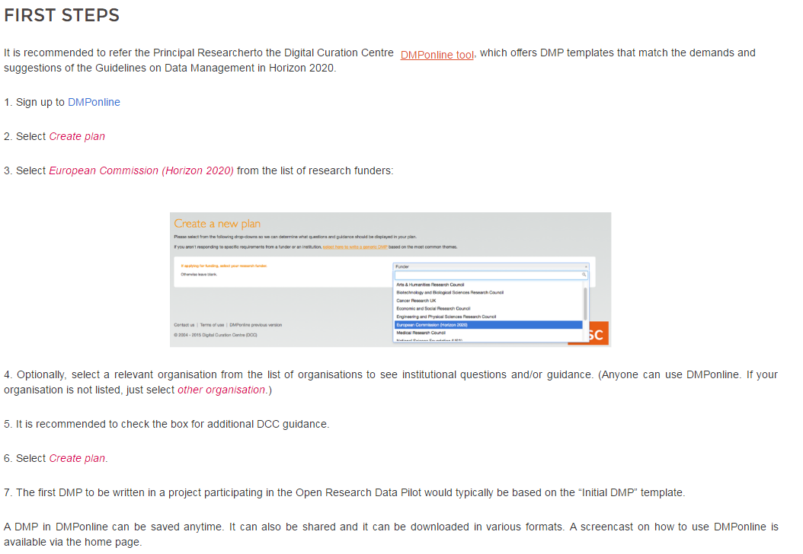
OpenAIRE guidelines on writing DMPs
https://www.openaire.eu/opendatapilot-dmp

Slide 32
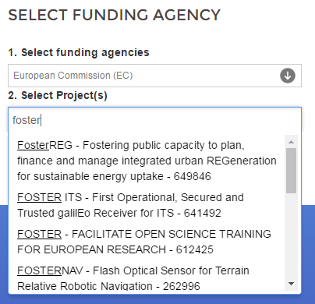
OpenAIRE plans with DMPonline
Adding option to allow projects to deposit DMP in Zenodo as way to publish plan and obtain a DOI
Considering using OpenAIRE API to let PIs select their H2020 project to automatically populate grant ID field and link the DMP with other outputs

Slide 33
Example H2020 DMPs in Zenodo
Helix Nebula – High Energy Physics example
https://zenodo.org/record/48171#.WATexnriF40
Tweether – engineering (micro-electronics) example
https://zenodo.org/record/55791#.WATei3riF40
AutoPost – ICT example https://zenodo.org/record/56107#.WATefXriF40
More listed at: www.dcc.ac.uk/resources/data-management-plans/guidance-examples

Slide 34
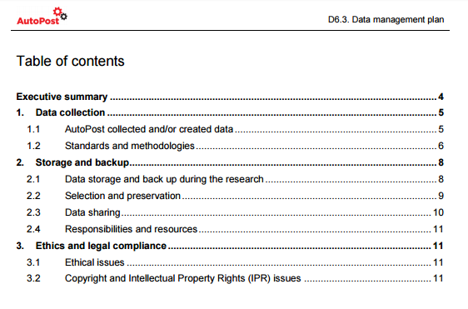
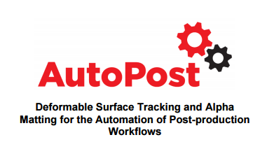
Example: AutoPost
An industry-driven innovation action that will deliver ICT-based solutions to enhance established post-production workflows
Have adopted their own structure to create DMP

Slide 35
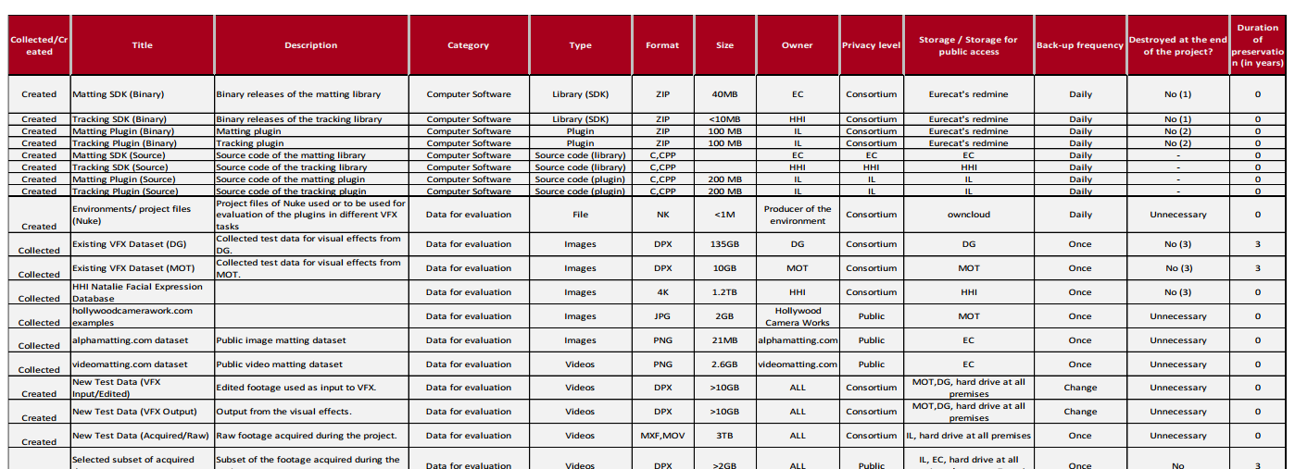
Example: AutoPost
Covers a range of existing and new data:
Evaluation / test data
Computer software
Research data and metadata
Manuscripts
Dissemination material

Slide 36
Making data open
Image CC-BY-NC-SA by Leo Reynolds www.flickr.com/photos/lwr/13442910354

Slide 37
How to make data open?
Choose your dataset(s)
What can you may open? You may need to revisit this step if you encounter problems later.
Apply an open license
Determine what IP exists. Apply a suitable licence e.g. CC-BY
Make the data available
Provide the data in a suitable format. Use repositories.
Make it discoverable
Post on the web, register in catalogues…
https://okfn.org

Slide 38
License research data openly
This DCC guide outlines the pros and cons of each approach and gives practical advice on how to implement your licence
CREATIVE COMMONS LIMITATIONS
NC Non-Commercial
What counts as commercial?
ND No Derivatives
Severely restricts use
These clauses are not open licenses
Horizon 2020 Open Access guidelines point to:
or
www.dcc.ac.uk/resources/how-guides/license-research-data
Notes:
Guidance from the DCC can also help researchers to understand data licensing. This guide outlines the pros and cons of each approach e.g. the limitations of some CC options
The OA guidelines under Horizon 2020 point to CC-0 or CC-BY as a straightforward and effective way to make it possible for others to mine, exploit and reproduce the data. See p11 at: http://ec.europa.eu/research/participants/data/ref/h2020/grants_manual/hi/oa_pilot/h2020-hi-oa-pilot-guide_en.pdf
38

Slide 39
EUDAT licensing tool
Answer questions to determine which licence(s) are appropriate to use
http://ufal.github.io/lindat-license-selector

Slide 40
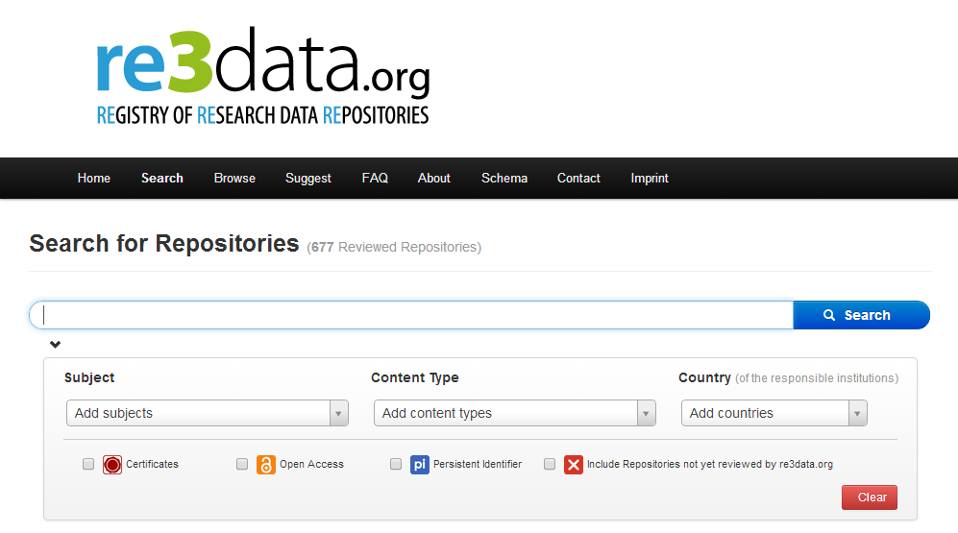
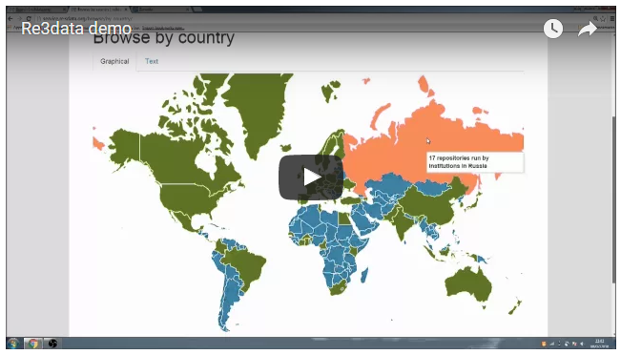
Deposit in a data repository
The EC guidelines point to Re3data as one of the registries that can be searched to find a home for data
http://databib.org
http://service.re3data.org/search
www.fosteropenscience.eu/content/re3data-demo
Notes:
40

Slide 41
How to select a repository?
Look for provision from your community, university, publisher, funder etc
Check they match your particular data needs: e.g. formats accepted; mixture of Open and Restricted Access.
See if they provide guidance on how to cite the deposited data.
Do they assign a persistent & globally unique identifier for sustainable citations and to links back to particular researchers and grants?
Look for certification as a ‘Trustworthy Digital Repository’ with an explicit ambition to keep the data available in long term.
www.openaire.eu/opendatapilot-repository

Slide 42
Zenodo
Zenodo is a multi-disciplinary repository that can be used for the long-tail of research data
An OpenAIRE-CERN joint effort
Multidisciplinary repository accepting
Multiple data types
Publications
Software
Assigns a Digital Object Identifier (DOI)
Links funding, publications, data & software
www.zenodo.org
Notes:
42

Slide 43
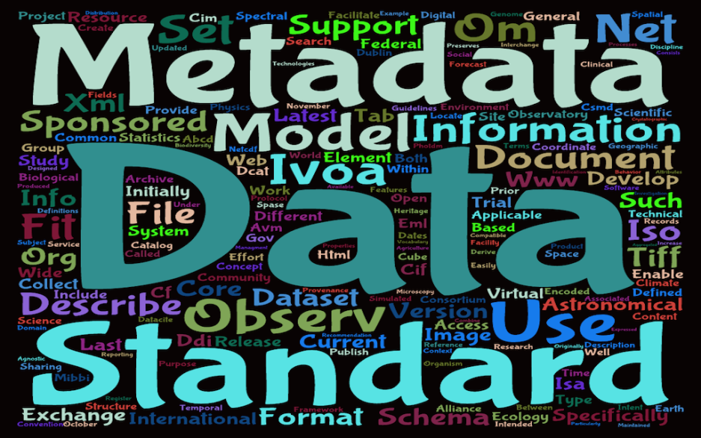
Use metadata standards
Metadata Standards Directory
Broad, disciplinary listing of standards and tools. Maintained by RDA group
http://rd-alliance.github.io/ metadata-directory
Biosharing
A portal of data standards, databases, and policies
Focused on life, environmental and biomedical sciences
https://biosharing.org

Slide 44
Choose appropriate file formats
If you want your data to be re-used and sustainable in the long-term, you typically want to opt for open, non-proprietary formats.
Type | Recommended | Avoid for data sharing
Tabular data | CSV, TSV, SPSS portable | Excel
Text | Plain text, HTML, RTF PDF/A only if layout matters | Word
Media | Container: MP4, Ogg Codec: Theora, Dirac, FLAC | Quicktime H264
Images | TIFF, JPEG2000, PNG | GIF, JPG
Structured data | XML, RDF | RDBMS
Further examples:
www.data-archive.ac.uk/create-manage/format/formats-table

Slide 45
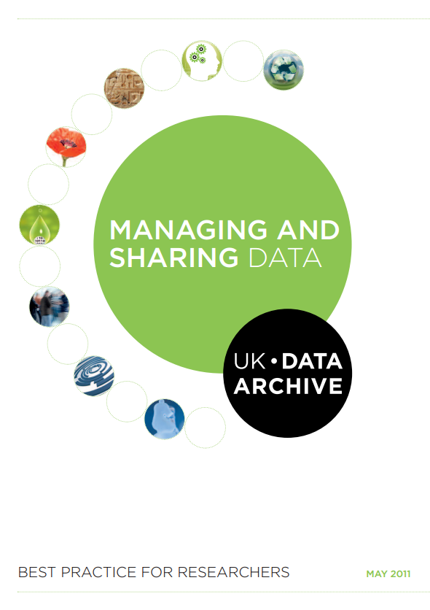
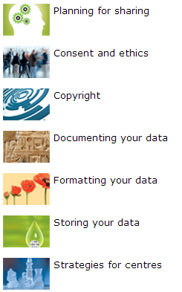
Managing and sharing data: a best practice guide
http://data-archive.ac.uk/media/2894/managingsharing.pdf

Slide 46
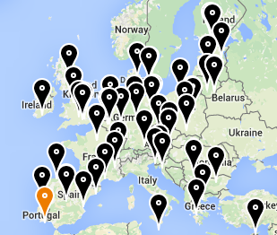
FOSTER and FOSTER+
Facilitate Open Science Training for European Research
Network of open access trainers
Programme of open science courses
Portal to training materials
E-learning courses
Focus on disciplinary materials in FOSTER+
www.fosteropenscience.eu

Slide 47
OpenAIRE
Open Access Infrastructure for research in Europe
aggregates data on OA outputs
mines & enriches it content by linking thing together
provides services & APIs e.g.
to generate publication lists
or support EC reporting
lots of guidelines on H2020
Open Data pilot and DMPs
www.openaire.eu
http://vimeo.com/108790101
Notes:
OpenAIRE is also worth checking out. This is an EC-funded project to provide infrastructure for open access. They’ve recently released a short video that tells you how they can help.
Essentially OpenAIRE aggregates metadata from different repositories to compile a complete list of publications and related outputs. They mine and enrich the content, de-duplicating entries and linking together publications with data, details about the project, authors, funders etc. OpenAIRE also provides a number of useful services & APIs, for example you can embed a publication list for your project in your website that is automatically updated whenever someone adds a new paper to a repository (this is harvested into OpenAIRE and pushed out to your list).

Slide 48
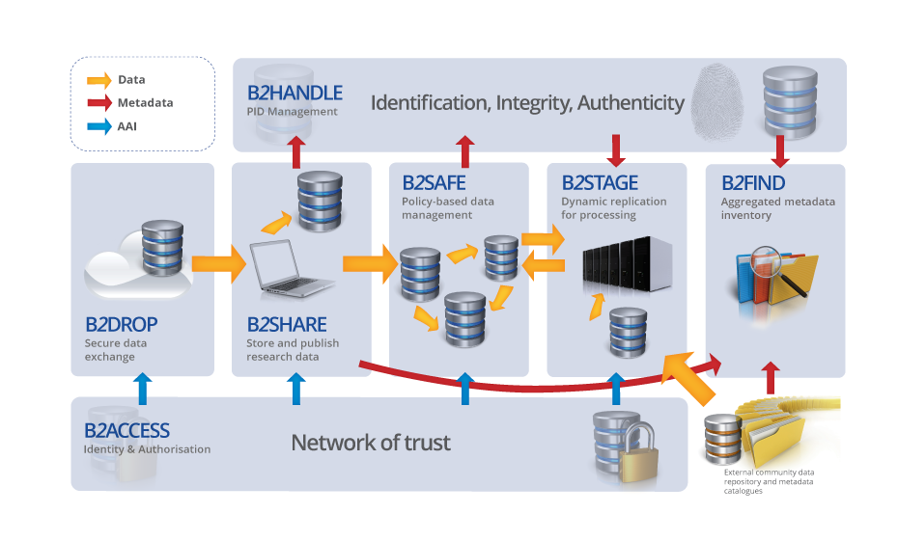
EUDAT services
EUDAT offers a pan-European solution, providing a generic set of services to ensure minimum level of interoperability
Building common data services in close collaboration with 25+ communities
www.eudat.eu
Notes:
All share common challenges:
– Reference models and architectures
– Persistent data identifiers
– Metadata management
– Distributed data sources
– Data interoperability

Slide 49
Discipline-specific infrastructure
ELIXIR in life sciences
BBMRI-ERIC (biobank and biomedical resources)
Euro Argo ERIC (oceanography)
CLARIN for language resources
DARIAH-EU for arts and humanities

Slide 50
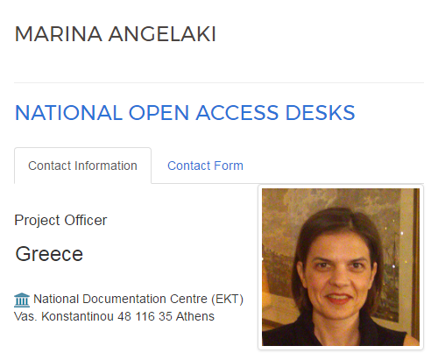
Tap into national & local support!
http://sodanet.gr
www.openaire.eu/contact-noads

Slide 51
Key messages
Data management is part of good practice whether you plan to make the data open or not
it benefits you!
The process of planning is the most important aspect. Think about the desired end result and plan for this.
Plan to share data from the outset - decisions you make early on affect what you can do later.

Slide 52
Thanks for listening
DCC resources on Data Management
www.dcc.ac.uk/resources
Follow us on twitter:
@digitalcuration and #ukdcc

