Slide 1
Dr Elias Nassiopoulos,CEO GIVE
HIF, 20/06, 2019

Slide 2
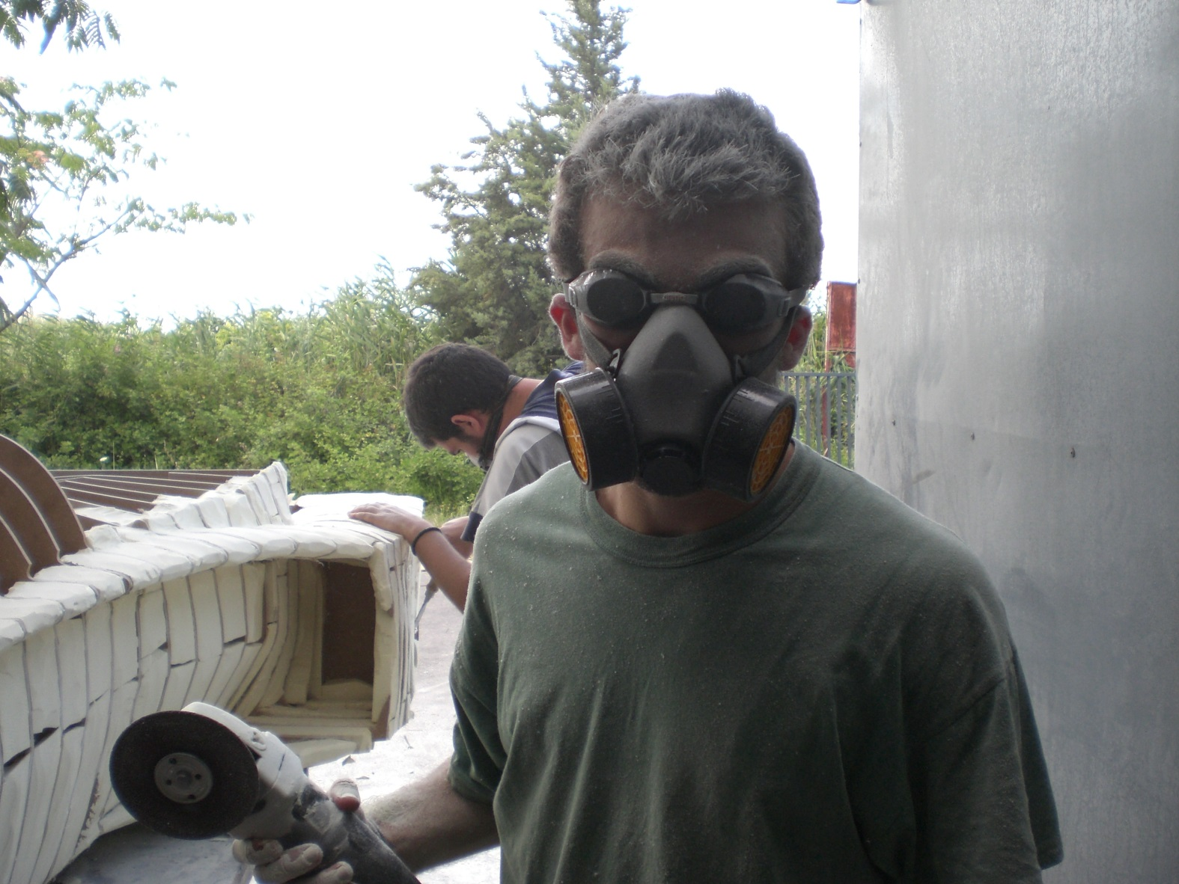
Notes:
Autos eimai egw. Kapou to 2007.
Apo pisw enas aderfikos filos kai sinadelfos, kai fotografos o giannis.
Auti einai mia fotografia apo tin kataskeui tis prwtis formulas tou aristoteleiou, mia prospatheia pou ksekinise apo diki mou protovoulia, kai ekselixtike se autin tin omorfi kai polu simantiki gia tin sxoli prospatheia.
I omada kleinei se ligo ta deka tis xronia. Me 4 oximata kai ena pou ftiaxnete, kai polles diakriseis.
Ti ekana egw se auta ta sxedon deka xronia…?

Slide 3
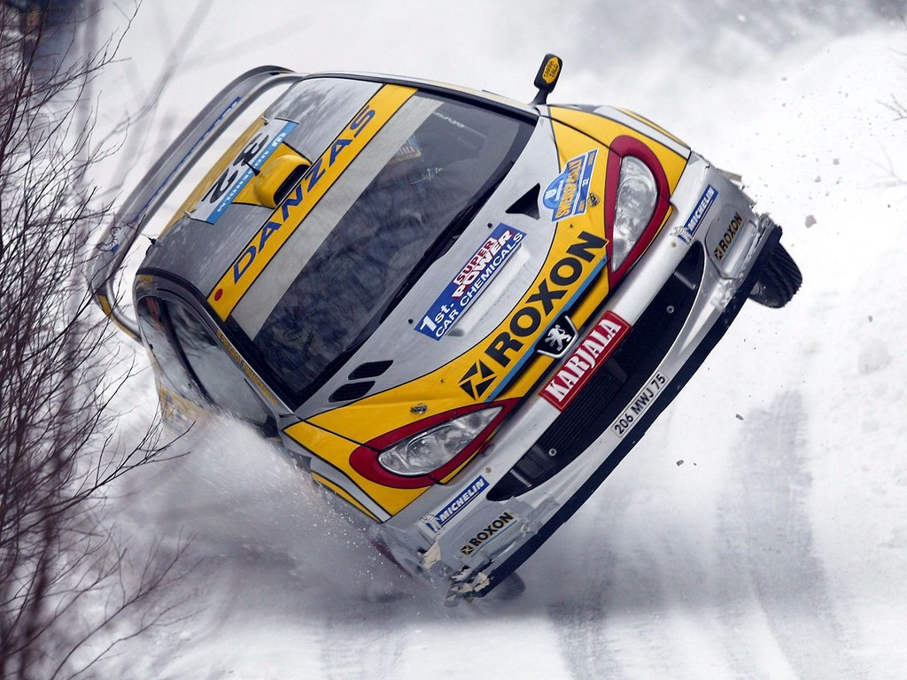

Slide 4
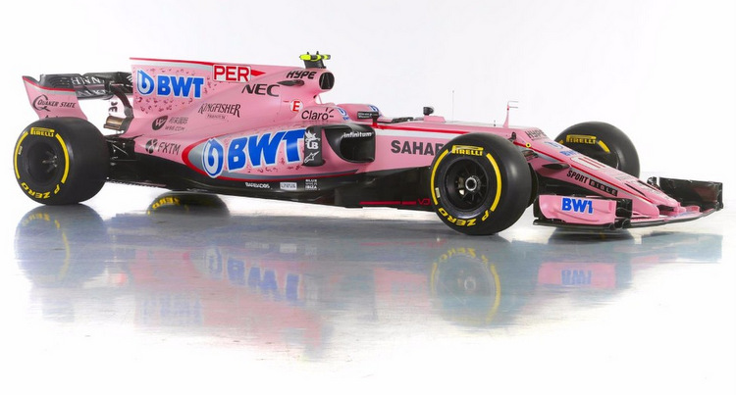

Slide 5
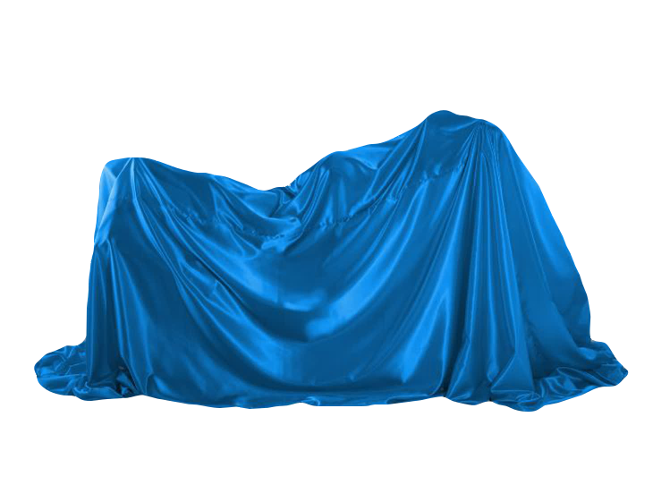

Slide 6
The best way to predict the future
is to create it
Notes:
And finally I was asked to present here some numbers stating what we are asking for.
I prefer to say, that we are looking for is people who believe what we believe, people that see the importance and beauty behind our crazy idea, and are willing to take this trip with us.

